Slide 1
San Joaquin General Hospital
IT team:
Team Lead - Brian Frank
System Engineer - Yingqi Mou
Software Engineer - Xiaoke Hu
Support Engineer - Rujuta Tamhankar
QA Engineer - Bharati Kandakumar
Product Manager - Penny Peng
Data Analyst - Mytreyi Reddy
Powerpoint Template from https://www.free-powerpoint-templates-design.com/
Notes:
hello everyone, this is San Joaquin General Hospital
we are from the IT department
I’m the product manager, Penny
we are a rural hospital out of Fresno
with very limited resources, currently we have a legacy electronic record system, which doesn’t include a comprehensive reporting function

Slide 2
Two Pain Points
 | Patients: Unsatisfied
Scheduling Mistakes - Loss of Revenue
Negative Reviews - Scare Away Prospects
 | Surgeons: Frustrated
Unbalanced Schedule - Underutilized Staff
Mismatched Facility - Potential Malpractice
Notes:
so sadly for a lot of our operation process, it’s still conducted in a manual fashion, for example, our scheduling process is all by excel
so that brings a lot of mistakes such as double booking, mismatched facility or incorrect appointment info
so we’ve noticed some trouble under our surgery operations, which is our most common appointment and where our main profit come from
there two major pain points.
for our patients, when there’s scheduling mistakes, many patients will walk out of our hospital and never come back, that’s a loss of revenue to our practice forever
what’s worse, the patient will leave a 1-star review on yelp and complaint about our service, this can easily scare away many dozens of potential patients who won’t even come to our hospital in the first place
on the surgeon side, unbalanced schedules means sometimes the staff is underutilized, but other times they are overworked
and when the surgeon walks into a mismatched facility, that raises our risk of potential malpractice

Slide 3
“C.A.R.E”: Centrally Allocated Reporting Environment
01
A reporting function that provides accurate staff and facility availability
02
A scheduling function that supports real-time booking
03
An analytical function that tracks staff utilization and performance
Notes:
so what do we wanna change about it?
our hospital really needs 1 centralized platform that provides 3 functions
no.1, we need a reporting function that shows all of our staff schedules
no.2, it should allow us to make real-time booking in the system
lastly, it should allow us to track our staff utilization

Slide 4
Roadmap: July 2020 - June 2021
2nd Rollout: Real-time scheduling function goes live (real-time input and update)
4th Month
8th Month
12th Month
1st Rollout: Reporting function goes live (view only reports)
3rd Rollout:
Analytics function goes live (staff utilization and performance)
Notes:
so we plan to spread the work over a 1-year roadmap
and each function will take us about 4 month to finish
now our architect will dive into our 1st milestone which is our reporting funciton

Slide 5
What We Need?
Reports
To help us accomplish the new system, what functions does the OSS software need to have?
Charts
Data
Multiple Data Sources
Custom Code

Slide 6
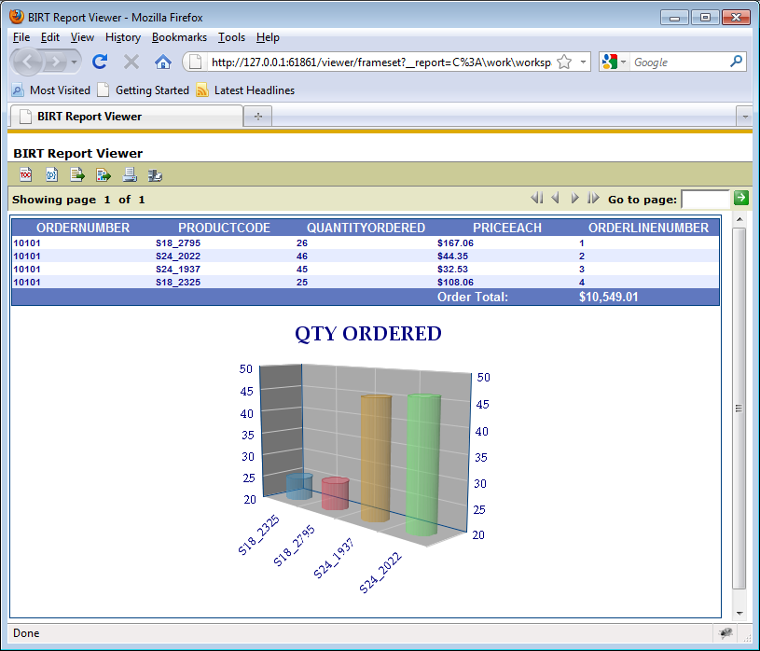
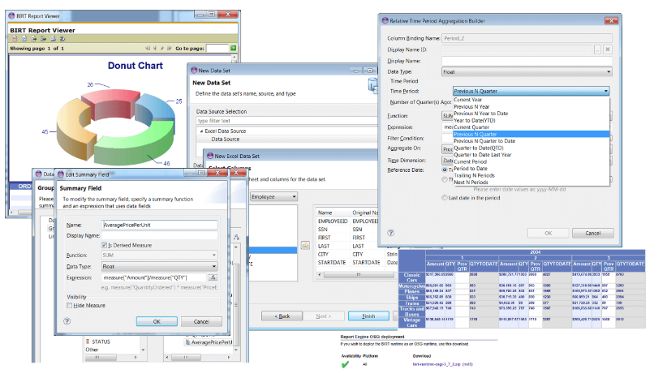
2
OSS
BIRT
BIRT - The Business Intelligence and Reporting Tools
3
BIRT is an open source software project that provides reporting and business intelligence capabilities for rich client and web applications¹
(SWOT analysis is included in appendix)
[1] Wikipedia. Retrieve from https://en.wikipedia.org/wiki/BIRT_Project
[2] Prepare Data for BIRT. Retrieve from https://www.iri.com/solutions/business-intelligence/bi-tool-acceleration/birt
[3] Birt world. Retrieve from http://birtworld.blogspot.com/2011/08/birt-viewer-export-data.html

Slide 7
Proposed System Diagram
Scheduling
Admin
Chief
Surgeon
Nurse Unit Manager
….
User Interface
Functions Layer
User Input to the system & System Report output to frontend
Application
SJG Reporting and Scheduling System
System’s API Layer
Call BIRT and receive data from BIRT
BIRT
BIRT
BIRT’s API Layer
BIRT’s API to extract and input data from different data sources
Database
EHRS
Facilities
DBMS

Slide 8
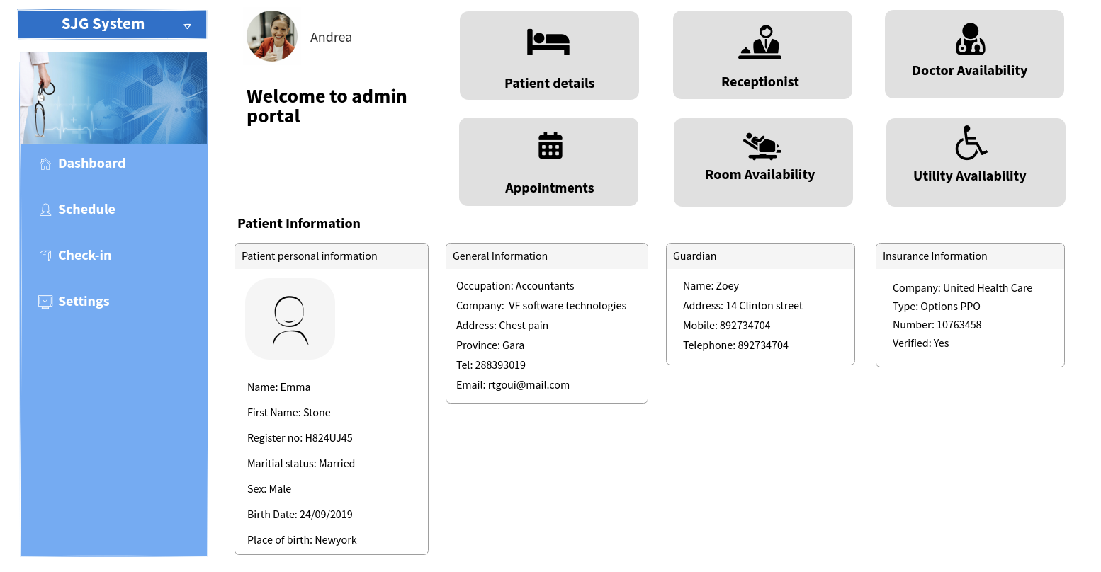
Notes:
UI created WireFramePro
Picture from https://www.strelcheck.com/home/website-picture-4/

Slide 9
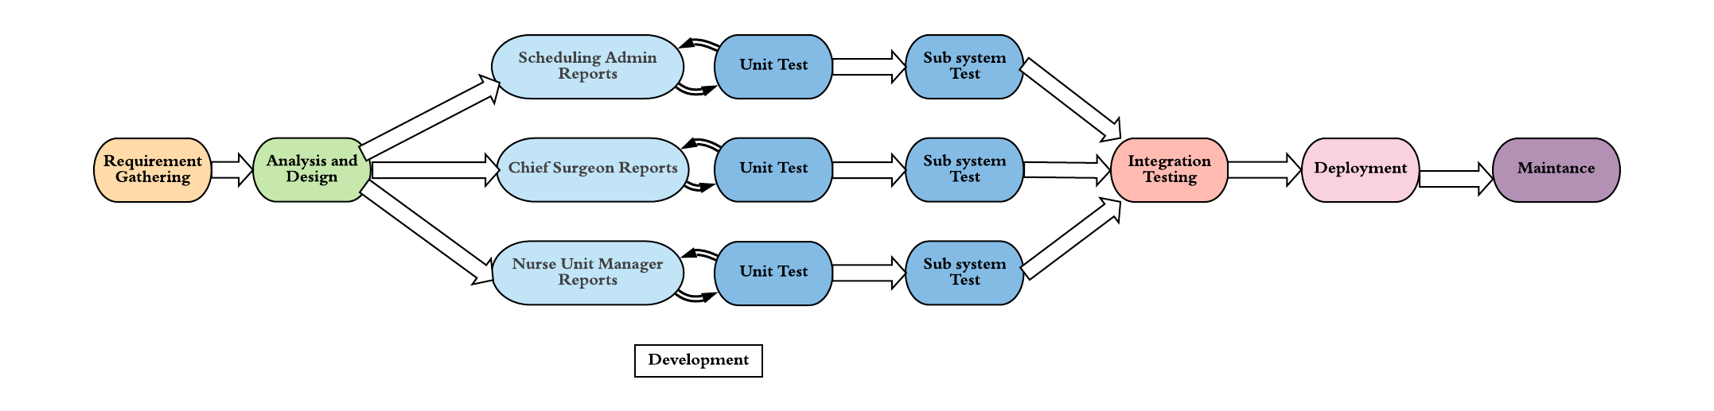
SDLC
Overall Waterfall
Incremental for Development and Testing
RAD for Integration
Notes:
Simple: 1 min

Slide 10
Release Map
Release 1.0
Contains the fundamental reporting platform that can access data and produce reports
Release 2.0
Contains a the ability for users to enter data into the database and other systems
Release 1.X
Minor releases will contain additional sets of reports as noted in the user stories for the persona
Release 1.X.X
DotDot releases will contain bug fixes, including data inconsistencies and report generation issues
Notes:
Simple: 1 min

Slide 11
Key Areas in Implementation
Issue
Mitigation
1
Patient Privacy and Data Security
Database access permissions are granted according to authorization level (based on persona). Database is only accessible via ethernet within the hospital network/premises.
2
Database Load Balancing /
Scale Management
Our system will use cache to reduce latency and avoid network congestion. We plan to increase server capacity during scaling.
3
User Acceptance
Pilot testing is planned before each release. Extensive user training is planned to include power-user to help lead training workshops.
Complete risk plan and technical illustration are included in appendix

Slide 12
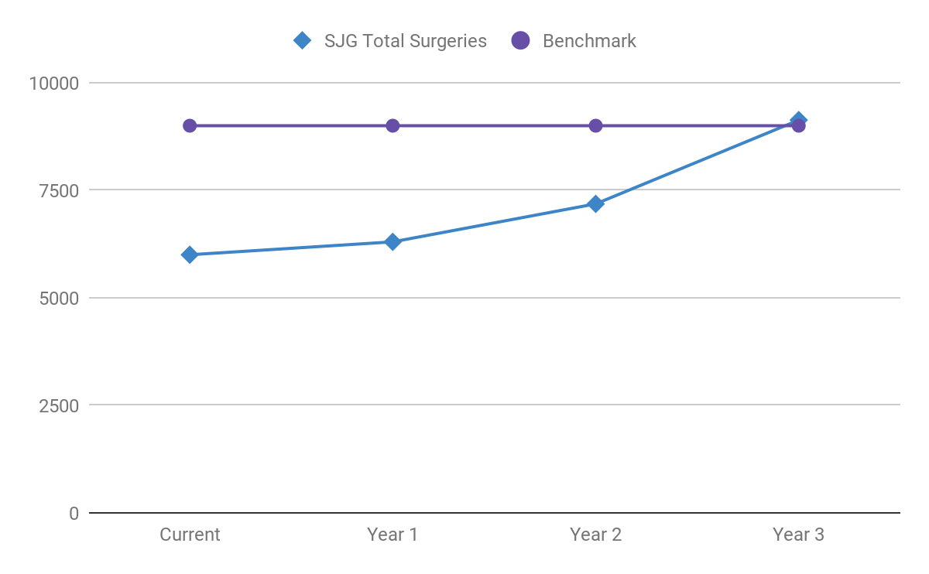
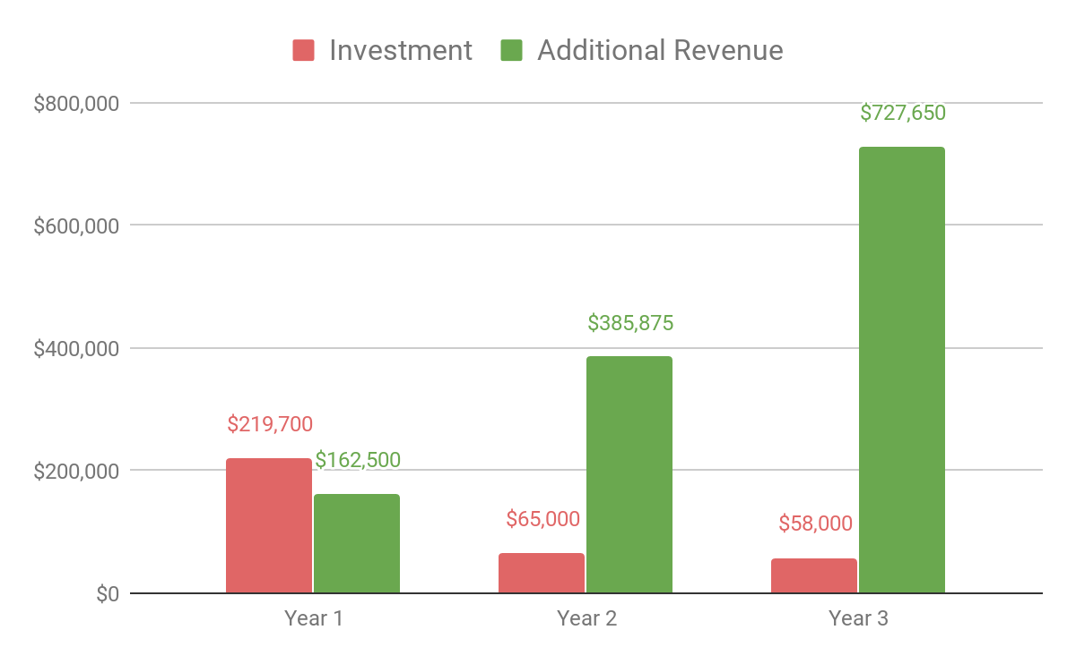
Return on Investment
Underlying assumptions and calculations are included in appendix
Notes:
Currently, due to our pour scheduling process, we underperform in benchmarks such as total number of surgeries and waiting time for the next surgery
With the new system, we should be able to increase the number of surgery appointments through better scheduling, as comparable hospitals have already doneW.
CLICK
e forecast that it can produce an increase in total surgery revenue of 5% in the first year, 11% in the second, and 22% in the third.
This creates an excellent monetary opportunity, especially compared to the relatively low investment.

Slide 13

A Value Proposition
Improve Patient Satisfaction
Increase Operational Efficiency
Enhance Staff Utilization
[4] Sasint. (n.d.). Nurse Caring for Patient in a Wheelchair. Retrieved from https://www.canva.com/photos/MADQ4wgczgI-nurse-caring-for-patient-in-a-wheelchair/
Notes:
Finally, rural hospitals such as San Joaquin General are the lifeblood of the community.
And saving lives isn’t just the job of the surgeon. It the job of everyone from scheduling admins to nurses to the facility teams.
Better staffed surgeries and easier scheduling processes give our customers the best opportunity for a full and healthy recovery.
CLICK
NOT USED
Surgeons who are less stressed, better staffed surgeries and an easier scheduling process for the customers (GIVES BETTER VALUE)
It’s a noble profession
A better service to the community
More appointments, more
Better life quality for patients and better surgery for patients

Slide 14
A Value Proposition
Healing is a matter of time,
but it is sometimes also a
matter of opportunity.
~ Hippocrates
Notes:
As Hippocrates once wrote “Healing is a matter of time, but it is sometimes also a matter of opportunity”.
This is our opportunity.
NOT USED
Surgeons who are less stressed, better staffed surgeries and an easier scheduling process for the customers (GIVES BETTER VALUE)
It’s a noble profession
A better service to the community
More appointments, more
Better life quality for patients and better surgery for patients

Slide 15
Q & A
Notes:
Thank you

Slide 16
Appendix Slides
Notes:
Thank you

Slide 17
Proposed Workflow with New System
Solution 1
Step 1
Step 2
Step 3
The patient calls in to schedule a surgery.
The scheduling admin retrieves relevant reports using the new system while on the phone with the patient
The scheduling admin books surgeon, room, day, and time of the surgery using the new system (This function will be implemented in 2nd launch)
Solution 1 (co-fix gap 1, gap 2, gap 4⁵): The scheduling admin retrieves surgeon availability report and operating room availability report from the system while speaking with the patient. This allows the patients to have more influence in the scheduling decision. The scheduling admin books the surgeon, room, day ,and time of the surgery right away while on the phone
[5] Please refer to gaps in the presenter's notes section
Notes:
Simple: 1 min
Notes:
Gap 1: Scheduling Admin cannot access Employees and Facilities Schedules to see the available surgeon/room/operating room staff to better assist patient with scheduling a suitable time.
Gap 2: Scheduling Admin reviews spreadsheets to match available surgeons and operating room staff. It’s very unclear and inefficient to match the best surgeon by comparing the information from three different spreadsheet
Gap 4: Facility information is stored in a different database from the EHRS, which increase the burden for data retrieve and store.

Slide 18
Proposed Workflow with New System
Solution 2
Solution 3
Step 4
Step 5
The nurse unit manager schedules the staff for surgery using the new system (This function will be implemented in 2nd launch)
The chief surgeon reviews surgery schedules to make sure the surgeries are properly scheduled
Solution 2 (co-fix gap 2,gap 3): The nurse unit manager retrieves the schedules of operating room staff on a daily basis so that they can staff surgical operations with the appropriate team members
Solution 3 (co-fix gap 1,gap 3): The chief surgeon (hospital administration leadership) reviews surgery schedules from the system on a daily and monthly basis to double check the scheduled surgeons, facilities and operating rooms for the surgeries are appropriate
Notes:
Simple: 1 min
Notes:
Gap 1: Scheduling Admin cannot access Employees and Facilities Schedules to see the available surgeon/room/operating room staff to better assist patient with scheduling a suitable time.
Gap 2: Scheduling Admin reviews spreadsheets to match available surgeons and operating room staff. It’s very unclear and inefficient to match the best surgeon by comparing the information from three different spreadsheet
Gap 3: Scheduling Admin knows which surgeons perform which surgeries, but lacks the domain knowledge to efficiently schedule operating room staff. Nurse Unit Manager knows who to schedule.

Slide 19
Proposed Workflow with New System
Solution 4
Step 6
Innovation
The scheduling admin, nurse unit manager, and chief surgeon review different reports based on their own needs
Solution 4 (fix gap 5): The scheduling admin reviews reports of surgery schedules to double check all the appointments are made correctly and in case on ad-hoc requests for schedule information
Innovation: The nurse unit managers and chief surgeon can review reports of surgery outcomes to better oversee the team performance
Notes:
Simple: 1 min
Notes:
Gap 5: Scheduling Admin doesn’t have an efficient way of finding surgery information if asked. They must consult the bulky daily consolidated report

Slide 20
Data Flow
1. User requests a report
Format: Button click, Text
2. System generates a query with inputted data and calls BIRT API
3. BIRT requests data from the appropriate data sources
SJG User
Interface
SJG System
BIRT
Data Source
6. A beautified and integrated report is displayed to the user
Format: HTML
5. Generated report is sent from BIRT to SJG system
Format: JSON, HTML, Excel, PDF, Doc, etc
4. Data is retrieved from the data source
Format: JSON, XML
Notes:
Simple: 1 min

Slide 21
Cache
To build a functionally efficient app, caching is one of the most significant aspects. Advantages include⁶:
Optimize app latency
Content availability
Example: When the network is off, nurse unit manager and chief surgeon need to check the daily/monthly report, cache enable the system provides the report in offline mode.
Avoids network congestion
Example: If the nurse unit manager wants to retrieve a 3 month report for team staff performance evaluation, cache would help to avoid network congestion when they want to see a longer time period information.
“Big wins from low-hanging fruit.” -Alex Landau
[6] Vinit S. (n.d.). How Caching Helps In Improving Performance Of Application. Retrieved from https://www.clariontech.com/blog/how-caching-helps-in-improving-performance-of-the-application
Notes:
Simple: 1 min

Slide 22
Competitive Analysis⁷
Competitive Analysis¹ of Options
 | BIRT
Eclipse Public License (EPL)
Windows, Linux, Mac OS X
YES
XML (RPTDESIGN)
YES
YES
YES
YES
 | Jaspersoft Studio
JasperReports Lib LGPLV3 JasperSoft Studio EPL
Windows, Linux, Mac OS X
YES
Report design files compile to Java Byte Code Deploy/Run .JASPER files
YES
YES
YES
No (Always scroll down even if crosstab expands side-by-side)
 | Pentaho
Pentaho Reporting LGPL V2.1 (or later)
Windows, Linux, Mac OS X
YES
XML Report file (.PRPT) is a ZIP of Design and other resources
YES
YES
No (Experimental)
No
License
Designer Platform
Eclipse Plug-in Available
Report Format
Sub-Reports
Side-by-side Report Components
Cross-tabs
Horizontal Planning
[7] Comparison Matrix. (n.d.). Retrieved from https://www.innoventsolutions.com/comparison-matrix.html

Slide 23
Cost Estimation
Product and Project Manager: $90/hr
While preparing these estimated numbers, the following assumptions were taken into consideration:
The product and project managers are involved throughout the entire product life cycle
The analyst will be involved in requirements, design and analysis phases (both high and low level)
Division of software, UI, and QA engineers is done based on the modules
For the deployment and maintenance will be done by the same employee (deployment engineer)
Analyst: $85/hr
Software and UI Engineer: $80/hr
QA Engineer: $65/hr
Deployment Engineer: $45/hr

Slide 24
Cost Estimation
The network configuration, setup, infrastructure and hardware costs $35,000 and it attributed to the 1st year of the project
A business consultant will be hired to review the metrics reports and provide strategies for process improvement. The business consultant charges a fee⁸ of $ 20,000 in first year, $15,000 in second year, $8,000 in 3rd year.
The 2nd and 3rd year will incur a maintenance fee $50,000, on average, which involves hosting fees, support hours to resolve any bugs or perform any enhancements by IT group (software engineer, data analyst, QA, etc)
[8] Consulting Fees & Rates: How Much Should I Charge? (n.d.). Retrieved from https://www.consulting.com/consulting-fees-rates

Slide 25
Hard Savings Estimate : Increase Outpatient Volume
With the reporting portal, the number of appointments can be managed efficiently. The scheduling admin report will greatly increase scheduling efficiency, reduce the amount of overlaps and double bookings of rooms, and allow us to increase the number of appointments per day. In turn, increased appointments will increase revenue.
The average revenue for the major outpatient consultations⁹ such as MRI scans, small surgeries, laboratory tests after operating expenses is $250
There are approximately 5,000 outpatient appointments per year. The estimated increase in the number of appointments over the next three years is 5% , 15%, and 30% respectively
Revenue Increase:
1st year: 5% * 5,000 * $250 = $62,500
2nd year: 15% * 5,250 * $250 = $196,875
3rd year: 30% * 6,038 * $250 = $452,850
[9] Most Common Outpatient Procedure Charges. (n.d.). Retrieved from https://www.universityhealth.org/patient-visitor-information/for-patients/billing-information/outpatient-pricing/

Slide 26
Hard Savings Estimate : Increase Inpatient Volume
Through proper resource allocation and surgery schedule optimization leads to availability of more beds and in turn leads to more surgeries and more revenue
The average revenue per inpatient surgery^{10,11} is $2,000 after operating expenses such as deducting salaries to doctors/physicians, nurses and admin staff
There are approximately 1,000 inpatient surgery appointments per year. The estimated increase in the number of surgeries over the next three years is 5% , 9%, and 12%, respectively
Revenue Increase:
1st year: 5% * 1,000 * $2,000 = $100,000
2nd year: 9% * 1,050 * $2,000 = $189,000
3rd year: 12% * 1,145 * $2,000 = $274,800
[10] Rappleye, E. (n.d.). Average cost per inpatient day across 50 states: Here are average costs per inpatient day in 2013, organized by hospital ownership type, in all 50 states and the District of Columbia, according to the latest statistics from Kaiser State Health Facts. Retrieved from https://www.beckershospitalreview.com/finance/average-cost-per-inpatient-day-across-50-states.html
[11] Fay, B. (2018, September 27). Hospital and Surgery Costs – Paying for Medical Treatment. Retrieved from https://www.debt.org/medical/hospital-surgery-costs/

Slide 27
Risk Table
 | Probability | Severity | Priority | Mitigation/Avoidance
Risk associated with data breach, specifically HIPAA requirements | High | High | High | Database access permissions are granted according to authorization level (based on persona and). Database is only accessible via Ethernet, and only within the hospital network/premises.
Risks associated with inadequate architecture, performance, quality¹² | Medium | High | High | Simulate or prototype the system and get benchmark of the system
Risks associated with any conversions of existing data, or clean up of “dirty” data from legacy database, required before implementation of a new system¹³ | Medium | High | High | Invest in first-class data quality software and consider hiring a specialist firm to assist. Assign the rights to create, approve, edit, or remove data from the source system to the skilled and authorized team members.¹⁴
Risk associated with hiring consultants from outside | Medium | High | High | Ensure that high quality consultants are hired, they are experts and highly equipped with the technical skills. Employees will cross-train with consultants to take advantage of knowledge transfer.

Slide 28
Risk Table
 | Probability | Severity | Priority | Mitigation/Avoidance
Risk associated with the Integration of new software tools with legacy system | High | Medium | Medium | Validate the data and results at each stage of the development process to ensure that bugs are not carried forward and they are resolved as soon as identified.
Risk associated with end-users not adopting the new reporting system | High | Medium | Medium | Conduct extensive user training including developing super-users to help lead training workshops
Project team members will not be in place¹⁵ | Medium | Medium | Medium | Plan for staffing resource and assign backup person for each critical technology: Currently out of scope but will be taken into consideration in the later phases of the project.
Acquisition of hardware and software resource¹⁵ | Low | Low | Low | Hardware and software needs for the project are satisfied. Additional cost is assigned for the Deployment Engineer for maintenance of the application.

Slide 29
Risk Assessment Matrix¹⁶
01
High
Medium
Risks that are more typical, with about a 50/50 chance of taking place
Low
Probability
Risks that are highly likely to occur
Risks that are relatively uncommon, but have a small chance manifesting
High
Medium
Risks with negative consequences, posing a moderate threat to the project.
Low
02
Severity
Risks with substantial negative consequences that will seriously impact the success of the project.
Risks that have a small potential for negative consequences, but will not significantly impact overall success.
High
Medium
Low
03
Priority
These are serious risks that both have significant consequences, and are likely to occur.
Somewhat likely to occur, these risks come with slightly more serious consequences.
The consequences of the risk are minor, and it is unlikely to occur.
[16] All the Risk Assessment Matrix Templates You Need. (n.d.). Retrieved from https://www.smartsheet.com/all-risk-assessment-matrix-templates-you-need

Slide 30
Bibliography
All the Risk Assessment Matrix Templates You Need. (n.d.). Retrieved from https://www.smartsheet.com/all-risk-assessment-matrix-templates-you-need
Birt world. Retrieve from http://birtworld.blogspot.com/2011/08/birt-viewer-export-data.html
Comparison Matrix. (n.d.). Retrieved from https://www.innoventsolutions.com/comparison-matrix.html
Consulting Fees & Rates: How Much Should I Charge? (n.d.). Retrieved from https://www.consulting.com/consulting-fees-rates
Department of Energy. (n.d.). Software Development Risk Assessment (pg. 2). Retrieved from https://www.energy.gov/sites/prod/files/cioprod/documents/riskasmt.pdf
Fay, B. (2018, September 27). Hospital and Surgery Costs – Paying for Medical Treatment. Retrieved from https://www.debt.org/medical/hospital-surgery-costs/
Most Common Outpatient Procedure Charges. (n.d.). Retrieved from https://www.universityhealth.org/patient-visitor-information/for-patients/billing-information/outpatient-pricing/
NetApp. (2019). What Is Data Migration? Retrieved from https://www.netapp.com/us/info/what-is-data-migration.aspx
Prepare Data for BIRT. Retrieve from https://www.iri.com/solutions/business-intelligence/bi-tool-acceleration/birt
Rappleye, E. (n.d.). Average cost per inpatient day across 50 states: Here are average costs per inpatient day in 2013, organized by hospital ownership type, in all 50 states and the District of Columbia, according to the latest statistics from Kaiser State Health Facts. Retrieved from https://www.beckershospitalreview.com/finance/average-cost-per-inpatient-day-across-50-states.html
Sasint. (n.d.). Nurse Caring for Patient in a Wheelchair. Retrieved from https://www.canva.com/photos/MADQ4wgczgI-nurse-caring-for-patient-in-a-wheelchair/
Vinit S. (n.d.). How Caching Helps In Improving Performance Of Application. Retrieved from https://www.clariontech.com/blog/how-caching-helps-in-improving-performance-of-the-application
Wallmuller, E. (n.d.). Risk Management for IT and Software Projects. Retrieved from https://itq.ch/pdf/RM__ITProjekteV211.pdf
Wikipedia. Retrieve from https://en.wikipedia.org/wiki/BIRT_Project
Notes:
Backup: 0 min

